Slide 1
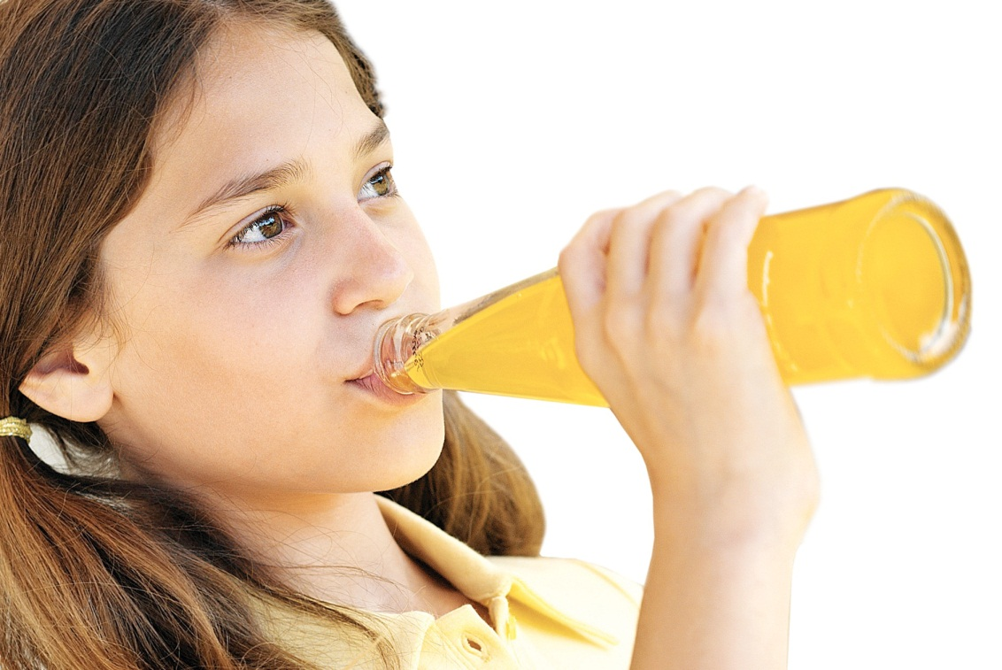
GLASS: good for you and the environment

Slide 2
GLASS is
all-natural and non-toxic.
WHY
GLASS protects
you by keeping chemicals out of your food & drinks.
GLASS
Food and drinks taste better in GLASS
IS
With GLASS, what you see is what you get – there is nothing to hide.
BEST
GLASS keeps what’s inside safe.

Slide 3
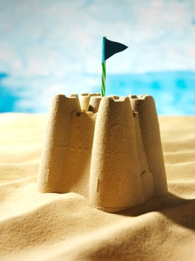
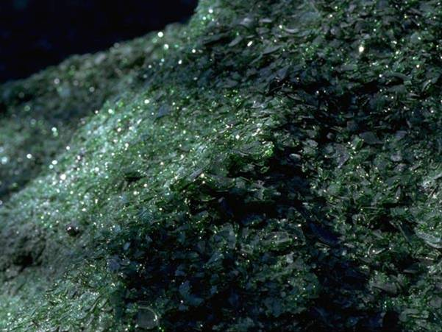
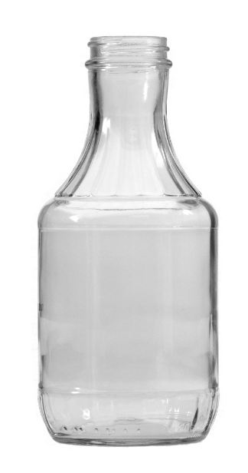
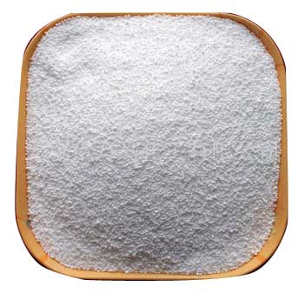
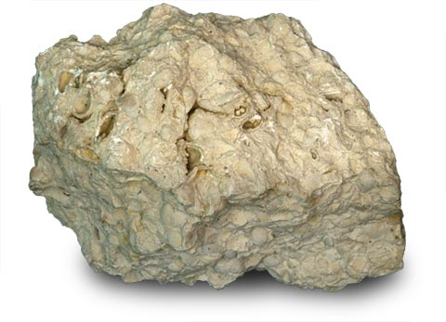
What glass is made of.
SAND
CULLET
LIMESTONE
SODA ASH

Slide 4
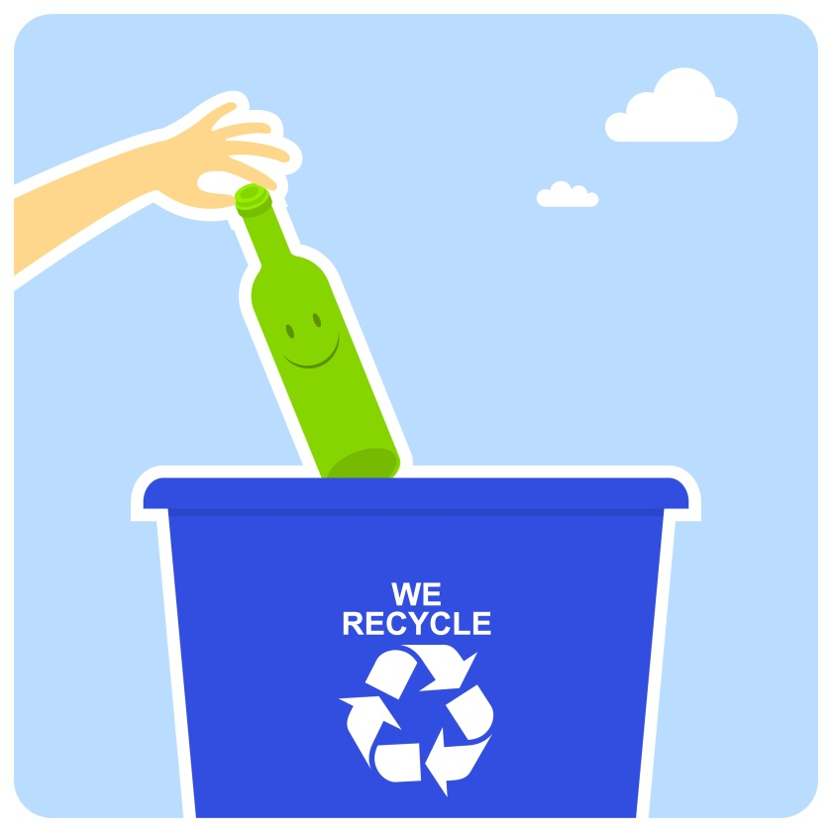
Kids can make a big difference!
1
Make sure you and your parents choose food and drinks in glass.
2
Tell your friends and family why
it’s so important to choose
and recycle glass.
3
Put all of your empty glass bottles and jars into the recycling bin. That’s where they belong – not in the trash can or on the side of the road!

Slide 5
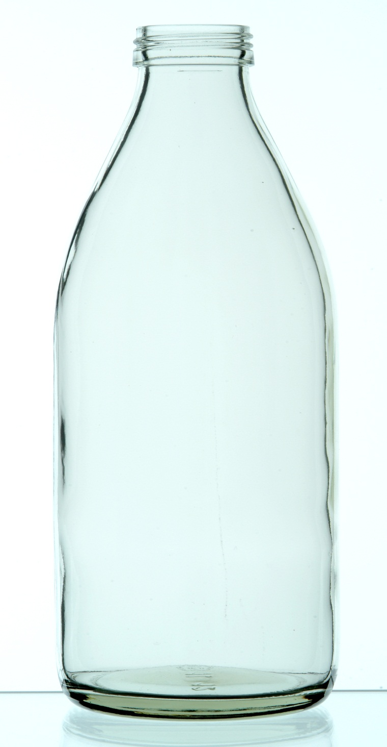
Did you know that glass containers can be recycled again and again forever?
soda
juices
pickle jars apple sauce
fruit bottled water
hot sauce jelly baby food jam
ketchup iced tea soy sauce pasta sauce salsa
What kinds of glass containers do you use at home that you can recycle?

Slide 6
How to recycle glass
1
Rinse out and clean your glass bottles and jars with water
2
Remove any caps or lids covering the containers and then put those caps and lids in the regular trash
3
Put glass containers in the recycling bin

Slide 7

Did you know…
Recycling one glass bottle saves enough energy to power a:
4 hours
30 minutes
20 minutes

Slide 8

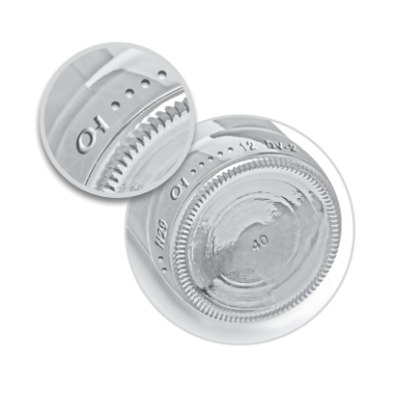
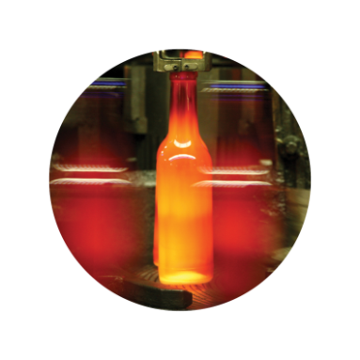
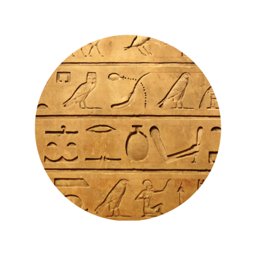
Fun glass facts.
O-I is based in Perrysburg
and makes more glass
bottles and jars than
any other company in
the world.
The tiny bump marks on
the bottom of your glass
bottles and jars tell a
story about who made them
and how. Look for O-I’s mark
on your bottles and jars.
Glass is made when sand
and other natural ingredients
are melted together at
temperatures up to 25%
hotter than the sun.
Lightning striking a beach
can make glass!
Glass bottles and jars have
been used for thousands
of years. The first glass
containers were made in
Egypt and Mesopotamia
around 1500 B.C.

